Slide 1
ENERGY
By Dr. Jitendra Satam

Slide 2
Energy
The sun, directly or indirectly, is the source of all the energy available on Earth. Energy is essential to life and all living organisms.
Energy is a conserved quantity and the law of conservation of energy states that energy can neither be created nor destroyed but can only be converted from one form to another.
The SI unit of energy is Joule.

Slide 3
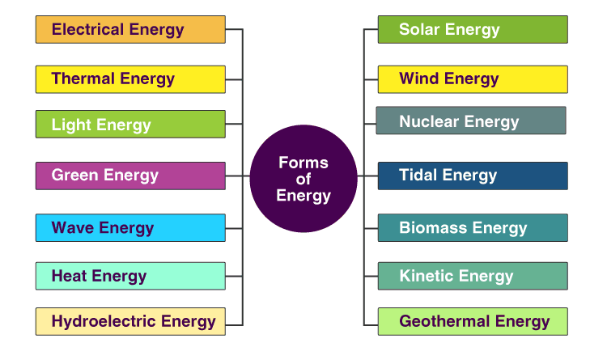
Types of Energy

Slide 4
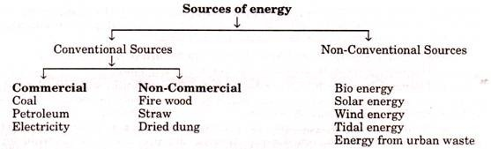
Classification of Energy

Slide 5
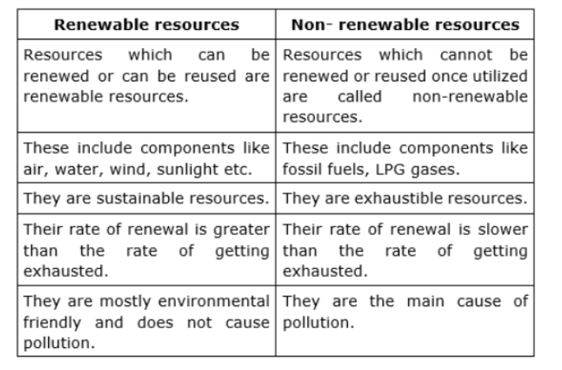
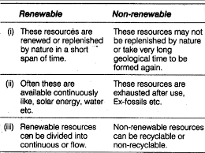
Distinction: Conventional (non-renewable) and nonconventional energy (renewable) sources.

Slide 6
Solar Energy
The electromagnetic radiation from sun is commonly known as solar energy. These radiations are
resulted from thermo nuclear fusion reaction on the surface of sun. All the radiation from the sun is not
in the same wavelength range. Almost 92% lie in the range of 315 nm to 1400nm. The estimated
amount of solar flux reaching the atmosphere of earth is approximately 1400W/m2min.and that of heat
equivalent is 2.68 X 10²⁴ J/Year. The eco system of earth utilizes about 0.2-0.5 % of total amount of
solar energy received. It indicates clearly that large amount solar energy get wasted, which otherwise
can be immense use for satisfying needs of humans.
Advantage of solar energy:
1. It is non-polluting and non-depleting source of energy.
2. It is renewable source of energy.
3. It is available abundantly.
In spite of these advantages, the use of solar energy in large scale is still not in practice, due to
following reasons,
1. Non availability of intense light in all areas throughout year
2. Difficulties faced in economic collection and conversion of solar energy into other forms of
energy such as electricity.
The solar energy has been successfully used in following purpose
i) Heating: Used for water and space heating in colder countries.
ii) Electricity: Using solar energy electric energy can be generated.

Slide 7
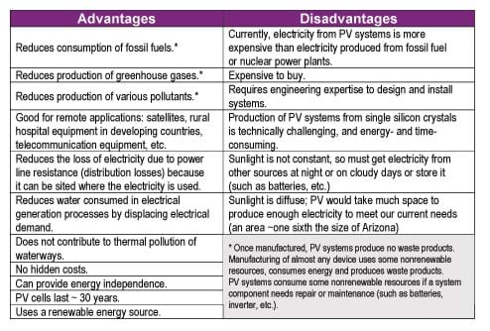
Advantages and Disadvantages

Slide 8
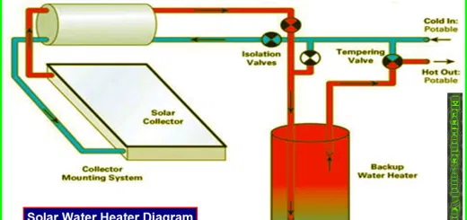
Solar Water Heater

Slide 9
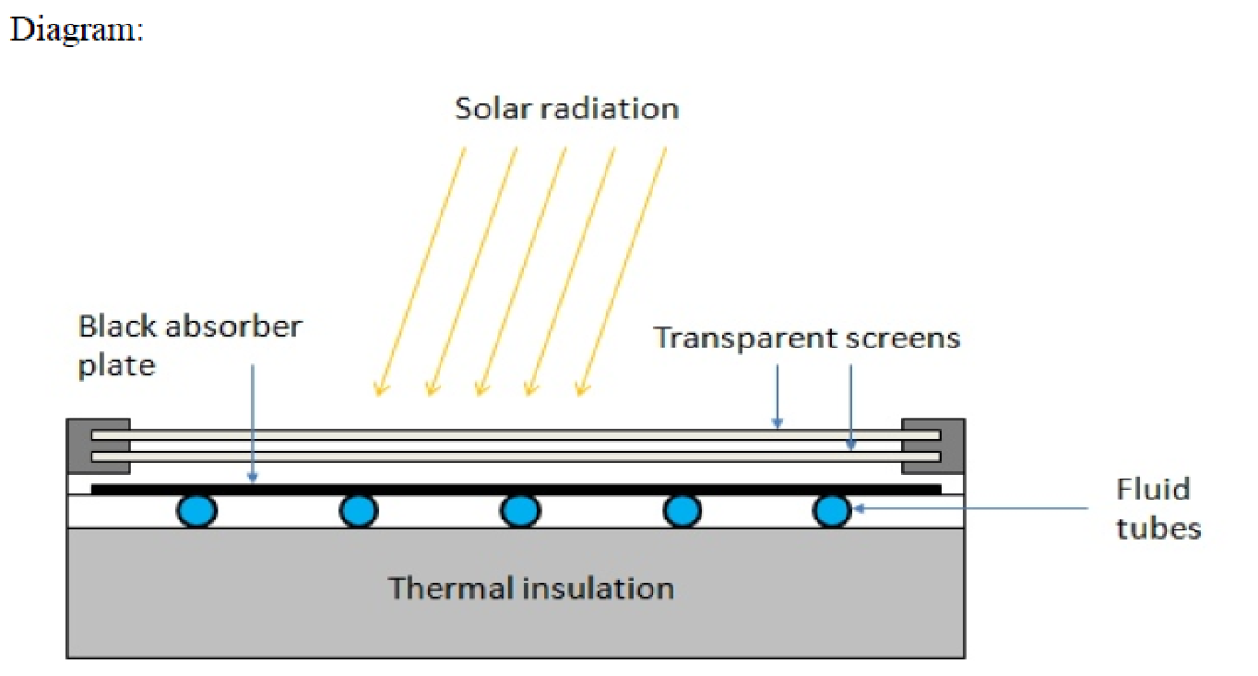
Flat Plate Collector:
The device works on the principle of black body in which heat absorbing capacity and tendency of a black surface is utilized to achieve benefits for human.
Construction:
These are the main components of a typical flat-plate solar collector:
• Black surface - absorbent of the incident solar energy
• Glazing cover - a transparent layer that transmits radiation to the absorber, but prevents radiative
and convective heat loss from the surface
• Tubes containing heating fluid to transfer the heat from the collector
• Support structure to protect the components and hold them in place
• Insulation covering sides and bottom of the collector to reduce heat losses
Application
Some advantages of the flat-plate collectors are that they are:Easy to manufacture
• Low cost, Collect both beam and diffuse radiation
• Permanently fixed (no sophisticated positioning or tracking equipment is required)
• Little maintenance

Slide 10
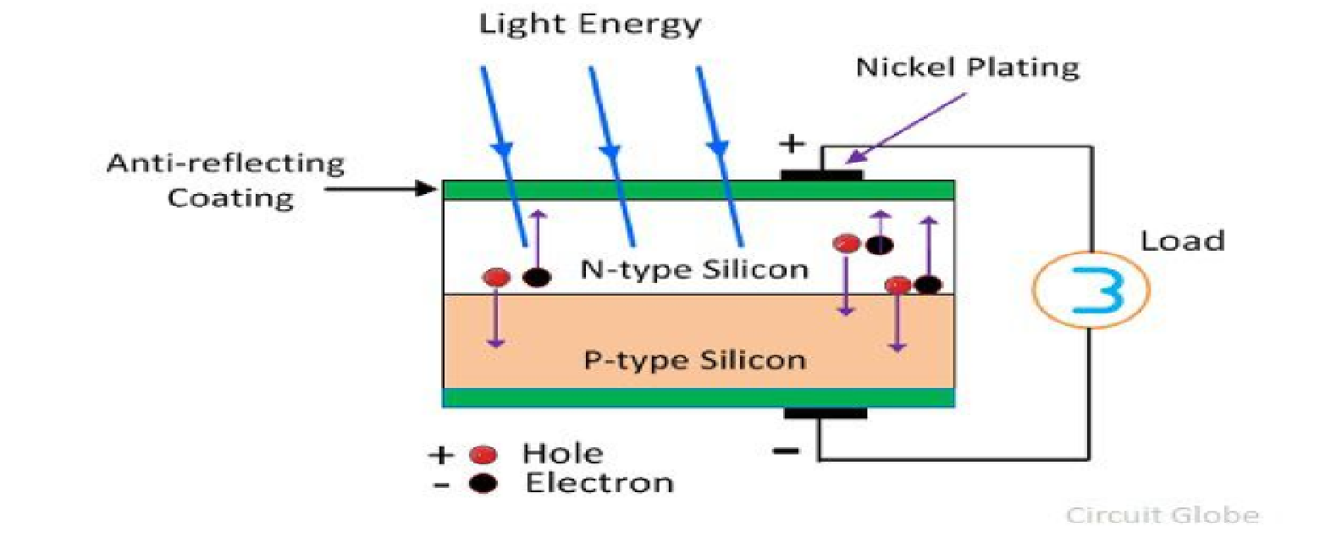
PHOTO VOTAIC CELL (SOLAR CELL) A conventional solar cell structure is shown in figure:
Semiconductors like silicon has the capacity to absorb light and deliver a portion of the energy of the
absorbed photons to carry charge carriers (electrons and hole).Thus solar cell is a semiconductor
diode that has been designed carefully so that it can absorb the light energy efficiently and convert
light energy from the sun into electrical energy.

Slide 11
Construction: A typical silicon photo voltaic cell composed of thin layer of phosphorus doped silicon (n-type) on top of boron doped (p-type) silicon. Hence these two layers form p-n junction. A metallic grid is the electrical contact of the diode and allows light to fall on the semiconductor between the grid lines. An anti-reflective layer between the grid lines increases the amount of light transmitted to semiconductor.
Working: of tiny energy packets called photon. When light radiation falls on the p-n junction diode,
photons are absorbed and electron-hole pairs are generated. The electrons are diffused and collected
at the n-type end and holes are diffused and collected at the p-type end. When these two ends are
electrically connected through a conductor, there is a flow of current between the two ends through
the external circuit. Thus photoelectric current is produced and available for use. The current output
of a cell depends on its efficiency and size and is proportional to the intensity of sun light striking the
surface of the cell. Therefore, photovoltaic cells are connected electrically in series or parallel circuits to produce higher voltages, currents and power levels. A number of solar cells electrically connected
to each other and mounted in a support structure or frame is called a photovoltaic module. A
photovoltaic array is the complete power generating unit, consisting of any number of photovoltaic
modules and panels.

Slide 12
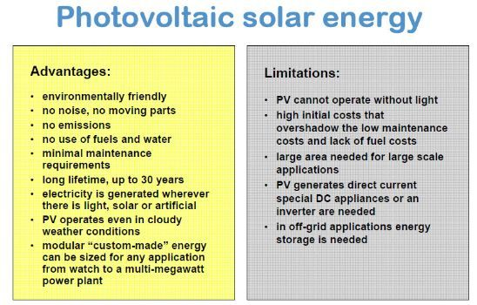
Advantages & Disadvantages

Slide 13
Fuel cells
H2-O2 fuel cells-Self Study
Fuels can be defined as substances which undergo combustion in the presence of air to produce a large amount of heat that can be used economically for domestic and industrial purpose.
Examples, Wood, Coal, Kerosene, Petrol

Slide 14
Classification of chemical fuels
Based on the origin: i) Primary or natural fuels
ii) Secondary or artificial or derived fuels
B) Based on Physical State: i) Solid Fuels
ii) Liquid Fuels
iii) Gaseous Fuels
C) Based on Chemical Nature
Organic eg. Vegetable fuel, coal
Inorganic eg. Iron Pyrites
Nuclear Fuels eg. Uranium oxide

Slide 15
Characteristic Properties of Fuels
Fuels are characterized by testing certain physical and chemical properties.
Calorific Value should be as high as possible.
Ignition temperature-Moderate
Flame temperature should be as high as possible.
Flash and Fire point should be as high as possible.
Aniline point should be low.
Cloud and Pour point should be as low as possible.
Viscosity should be adequate.
Coke number should be as high as possible.
Moisture content-as low as possible.
Volatile matter as low as possible.
Ash content should be absent.
Easy risk free transport should be possible.
Storage space-ideally fuel should occupy small space.
Air requirement- adequate
Harmless products should be produced on combustion.

Slide 16
Calorific Value
Calorific value is defined as the number of parts of water which gets heated through 1°C by the heat evolved by the complete combustion of one unit weight of fuel( unit volume of gaseous fuels) under the conditions such as
Whole of heat evolved is absorbed by water.
The products formed leave the system at atmospheric temperature and pressure.
It is the most important property of fuel.

Slide 17
Units of calorific value
B.T.U. (British Thermal Unit)
A British thermal unit may be defined as the heat required to raise the temperature of one pound of water from 60°F to 61°F.
2) K.C.U. (Kilogram Centigrade Unit)
The calorie, a unit of heat may be defined as, the heat required to raise the temperature of one Kg of water from 15°C to 16°C.
Correlation between BTU and KCU:
1BTU = 0.252KCal =252Cal
1KCal = 3.968 BTU
3) C.H.U. (Centigrade Heat Unit)
The calorific value can also be expressed as centigrade heat unit (C.H.U.)., which is the amount of heat required to raise temperature of one pound of water through one degree centigrade.

Slide 18
1) High Calorific value (HCV) or Gross Calorific value (GCV):
High calorific value may be defined as the total amount of heat produced when one unit of the fuel has been burnt completely and the products of combustion have been cooled to 16°C or 60°F.
2) Low calorific value( LCV) or Net Calorific value (NCV)
Low calorific value may be defined as the net heat produced when unit mass or volume of fuel is completely burnt and products are allowed to escape.
NCV or LCV = GCV (HCV) – Latent Heat of water formed
= GCV(HCV) – Mass of hydrogen x 9 x Latent heat of steam
= GCV(HCV) – 0.09 x %H x 587
Because 1 part by weight of hydrogen produces 9 parts (1+8) by mass of water.

Slide 19
Dulong Formula
The calorific value of fuels is determined theoretically by Dulong formula or I.A. Davies formula.
It is expressed as
Q = 1/100 [ 8080 x C + 34500 x (H – O/8) + 2240 x S]
Where, Q = Calorific value in KCU/Kg
C = % of carbon
H = % of hydrogen
O = % of oxygen
S = % of sulphur
Dulong formula for HCV & LCV
HCV = 1/100 [8080 x C + 34500 x (H – O/8) + 2240 x S]
LCV = HCV –[ 9/100 x %H x 587]
Experimentally calorific value of solid and liquid fuel is determined using Bomb Calorimeter.

Slide 20
Numerical 1: A sample of coal contains C = 55%, O = 28%, H =7%, S = 0.7%, N =0.2%, Ash = 0.2%. Calculate the GCV and NCV.
Soln:
GCV = 1/100[ 8080C + 34500(H-O/8) + 2240S]
= 1/100 [ 8080x55 + 34500(7-28/8) + 2240 x 0.7]
= 5667 Kcal/Kg
NCV = HCV – 0.09 x % H x 587
= 5667 – 0.09 x 7 x 587
= 5297.19Kcal/Kg
Numerical 2: A sample of coal has following composition C = 70%, O = 8%, H = 10%, N =3%, S = 2%, Ash = 7%. Calculate HCV and GCV.
Numerical 3: A sample of coal contains C = 61% , O = 32%, S = 0.5%, N = 0.2% and Ash = 0.3%. If NCV of coal is 5313.02KCal/Kg. Calculate % H and GCV.
GCV =1/100[8080C + 34500(H-O/8) + 2240S]----i)
NCV = GCV -0.09x%Hx587
GCV = NCV + 0.09x%H x587-------ii)
1/100[8080C + 34500(H-O/8) + 2240S) = NCV + 0.09x%Hx587

Slide 21
Numerical 3: A sample of coal contains C = 61% , O = 32%, S = 0.5%, N = 0.2% and Ash = 0.3%. If NCV of coal is 5313.02KCal/Kg. Calculate % H and GCV.
GCV =1/100[8080C + 34500(H-O/8) + 2240S]----i)
NCV = GCV -0.09x%Hx587
GCV = NCV + 0.09x%H x587-------ii)
1/100[8080C + 34500(H-O/8) + 2240S) = NCV + 0.09x%Hx587

Slide 22
Numerical 3: A sample of coal contains C = 70% , O = 25%, S = 1%, N = 1% and Ash = 0.5%. If NCV of coal is 5200KCal/Kg. Calculate % H and GCV.
GCV =80.80x70 + 345(H-25/8) + 22.40x1]----i)
=5656+345H-1078.125+22.4
= 4600+345H
NCV = GCV - 0.09x%Hx587
GCV = 5200 + 0.09x%H x587
= 5200 + 52.83H-------ii)
4600.275+345H = 5200 + 52.83H
345H- 52.83H = 5200-4600.275
292.17H = 599.725
H = 2.05%
GCV= 5308.44Kcal/Kg

Slide 23
Coal
Purpose of Analysis of Coal
To decide price of coal
To determine quality
To specify use of coal for a particular purpose.
To calculate theoretical calorific value of coal.
To calculate air requirement for complete combustion of coal and design the furnace fire box suitably.

Slide 24
Types of Analysis of Coal
Proximate Analysis
% Moisture
% Volatile Matter
% Ash
Fixed Carbon
B) Ultimate Analysis
% Carbon and % Hydrogen
% Nitrogen
% Sulphur
% Ash

Slide 25
Proximate Analysis of Coal
Proximate analysis is the study or analysis of coal sample in which
% Moisture b) % VM c) % Ash d) % Fixed Carbon are found out.
a) % Moisture
A known weight of powdered and air dried coal sample is taken in a crucible and it is places in an oven for 1hr at 110°C. Then the coal is cooled in a desiccator and weighed out. If the initial weight of the coal is W gms and final weight is W1 gms.
Then the loss in weight (W-W1) corresponds to moisture in coal.
% Moisture = Loss in weight x 100 = (W-W1) x 100
Weight of coal sample W

Slide 26
b) % Volatile Matter
Moisture free coal left in the crucible in first experiment W1 is covered with a lid loosely. Then it is heated at 925°C in a muffle furnace for 7min.
The crucible is taken out and cooled in a desiccator. Then it is weighed (W2 gms) .
% Volatile matter = weight of volatile matter x 100 = (W1-W2) x100
Weight of coal sample W
c) % Ash
The residual coal in the above experiments is heated and burnt in an open crucible at above 750°C for half hour.
The coal gets burnt. The ash left in crucible is cooled in a desiccator and weighed W3 gms.
% Ash = weight of ash x 100 = W3 x 100
Weight of coal W
d) % Fixed Carbon:
It is found by calculations
%FC = 100-[% moisture + % VM + % Ash)

Slide 27
Significance or Importance of proximate analysis
Moisture
It decreases calorific value of coal largely as it does not burn and takes away heat in the form of latent heat.
It increases ignition point of coal.
Hence a coal with lower moisture % is better quality.
b) Volatile matter
It decreases calorific value of coal.
It elongates flame and decreases flame temperature.
It form smoke and pollute air.
However the coals containing 15-25% of VM on carbonization gives coke oven gas which is source of various organic aromatic chemicals.
Such coal have good coaking property and coke can be obtained from the coals.
Overall regarding burning of coal the coal with lesser VM is better quality coal.
c) Ash
It reduces calorific value of coal as ash is non-burning part in coal.
Ash disposal is a problem.
Ash fuses to form clinker at high temperature obstructing the air supply of coal burning furnace.
Hence lesser the % ash better is the quality of coal.
d) Fixed carbon
Carbon is the burning part in coal and higher the fixed carbon higher is calorific value.
Hence a good quality coal contains high fixed carbon percentage.

Slide 28
Numerical 1: A sample of coal was analysed for content of moisture, volatile matter & ash. From the following data, calculate the percentage of the above quantities.
i) weight of coal taken = 2.5g
ii) weight of coal after heating ar 110°C = 2.365g
iii) weight of coal after heating at covered crucible at 950°C = 1.165g
iv) constant weight obtained at the end of the experiment = 0.460g
Soln:
% Moisture = (W-W1) x 100 = ( 2.5-2.365 )x 100 =5.4%
W 2.5
b) % volatile Matter = (W1-W2)x 100 = (2.365-1.165) x 100 = 48%
W 2.5
c) % Ash = W3 x 100 = 0.460 x 100 = 18.4%
W 2.5
d) % Fixed Carbon = 100 – [% moisture + % VM + % Ash]
= 100 – [5.4 + 48+ 18.4] = 28.2%

Slide 29
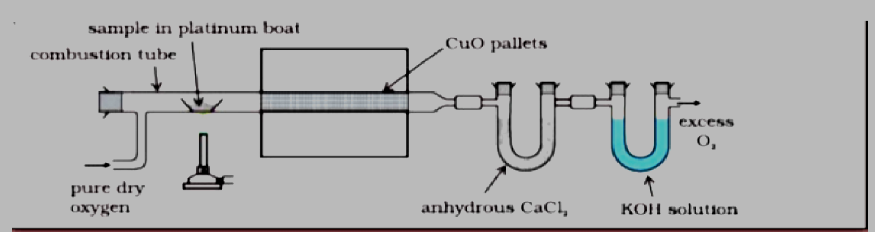
Ultimate Analysis
1) Carbon and 2) hydrogen:
About 1-2 g of accurately weighed coal sample is burnt in a current of oxygen in a combustion apparatus. C and H of the coal are converted into CO2 and H2O respectively. The gaseous products of combustion are absorbed respectively in KOH and CaCl2 tubes of known weights.
The increase in weights of these are then determined.
C + O2 ----->CO2
2H2 + O2-----> 2H2O
KOH + CO2-----> K2CO3 + H2O
CaCl2 + 7 H2O-----> CaCl₂.7 H2O

Slide 30


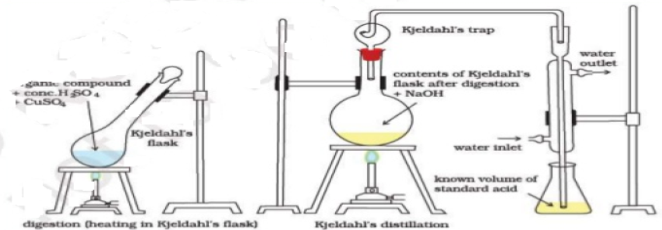

3) Nitrogen by Kjeldahl’s Method: About 1 g of accurately weighed powdered 'coal is heated with concentrated H2SO4 along-with K₂SO₄ (catalyst) in a long-necked flask (called Kjeldahl’s flask). After the solution becomes clear, it is treated with excess of KOH and the liberated ammonia is distilled over and absorbed in a known volume of standard acid solution. The unused acid is then determined by back titration with standard KOH solution. From the volume of acid used by ammonia liberated, the percentage of N in coal is calculated as:

Slide 31
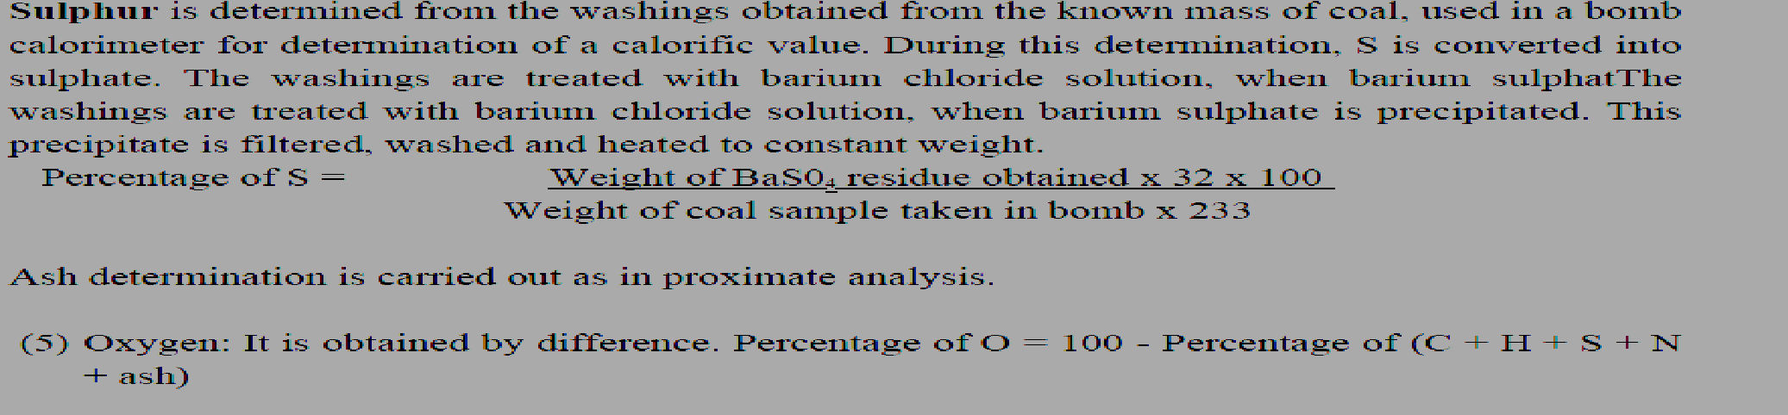
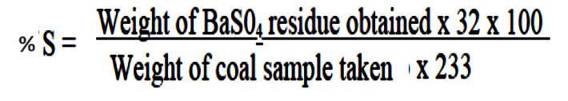
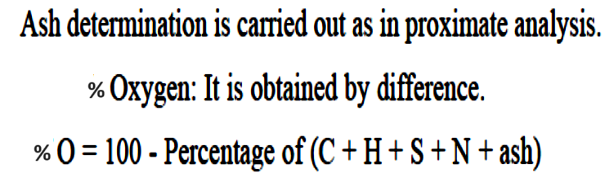

Slide 32
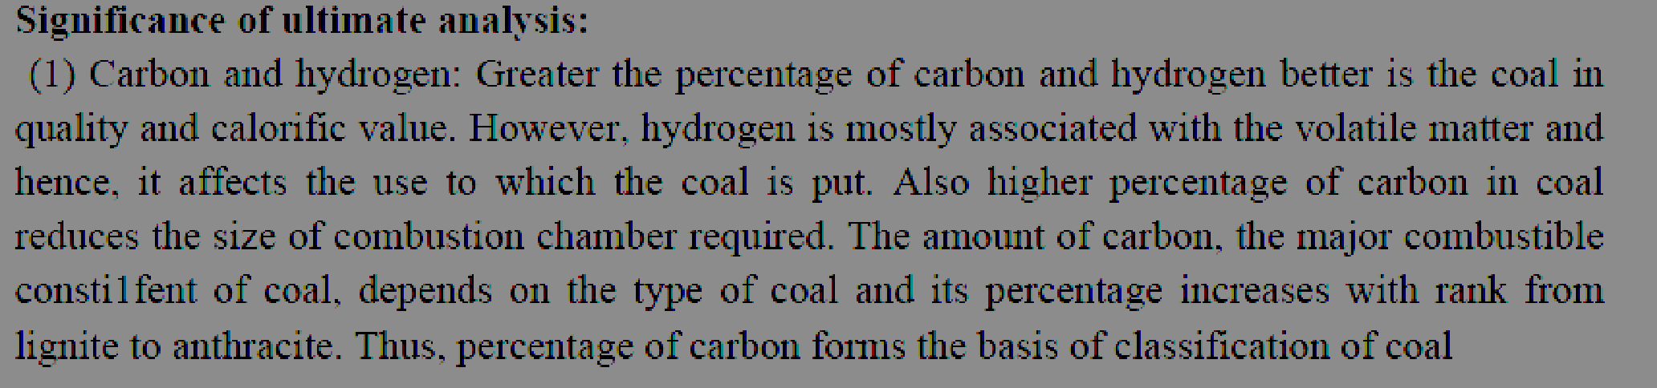
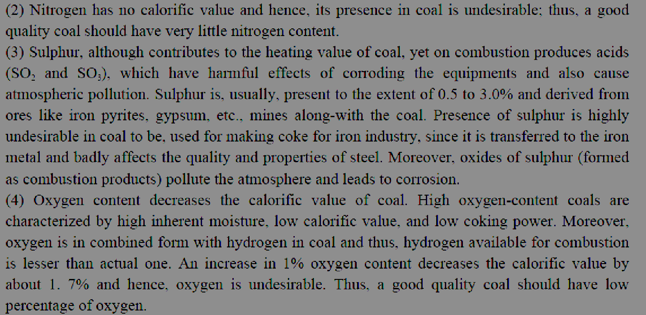

Slide 33
Numerical 1: 0.2g of Coal Sample is accurately weighed and is burnt in a combustion apparatus. The gaseous products of combustion are absorbed in potash bulb and calcium chloride tubes of known weights. The increase in weight of potash bulb and CaCl₂ tube are 0.66g and 0.08g respectively. Calculate the % C and % H in coal sample.
Numerical 2: 3g of coal was heated in Kjeldahls flask and NH₃ gas evolved was absorbed in 40mL of 0.5N HCl. After absorption the excess acid required 18.5mL of 0.5N KOH for exact neutralization. 2.3g of coal sample in quantitative analysis gave 0.35g BaSO₄. Calculate % of N and S in coal sample.
Soln: Volume of NH₃ consumed by 0.5N HCl is in terms of 0.5N KOH
40ml of 0.5N HCl = 40mL of 0.5N KOH---assumed---V1___blank
Unreacted acid = 18.5ml of 0.5N KOH----V2____back titration
Vol of acid reacted with absorbed NH₃ in term of 0.5N KOH = 40 – 18.5ml = 21.5mL
% N = volume of acid consumed(V₁-V₂) x N KOH x 1.4
weight of coal sample
% S = Wt of BaSO₄ formed x 32x 100
weight of coal sample x 233

Slide 35
BATTERIES
Batteries are essential power sources in our modern world, providing portable energy for a vast array of devices, from small electronics like smartphones and watches to larger applications such as electric vehicles and grid storage systems.
Batteries are devices that store and release electrical energy through electrochemical reactions and converts chemical energy into electrical energy.
The fundamental principle behind batteries involves converting chemical energy into electrical energy and vice versa. This process occurs within the battery cell, which consists of several key components:

Slide 36
Components of Batteries:
Electrodes: Batteries have two electrodes, typically referred to as the cathode and the anode. The cathode is the electrode where reduction (gain of electrons) occurs during discharge, while the anode is where oxidation (loss of electrons) takes place.
Electrolyte: An electrolyte is a substance that facilitates the movement of ions between the cathode and anode within the battery cell. It can be a liquid, gel, or solid material containing ions that allow for the flow of electrical charge.
Separator: The separator is a physical barrier between the cathode and anode within the battery cell, preventing direct contact between them while allowing the flow of ions. It helps to prevent short circuits and ensures the proper functioning of the battery.
Primary batteries and secondary batteries are two main categories of batteries distinguished by their ability to be recharged and reused.

Slide 37
Primary Batteries (Non-rechargeable):
Primary batteries, also known as non-rechargeable batteries, are designed for single-use applications.
Once the chemical reactions that generate electricity within the battery are exhausted, the battery cannot be recharged and must be disposed of.
Common types of primary batteries include alkaline batteries, zinc-carbon batteries, and lithium primary batteries.
They are widely used in devices where recharging is impractical or unnecessary, such as remote controls, disposable cameras, and some medical devices.

Slide 38
Secondary Batteries (Rechargeable):
Secondary batteries, also known as rechargeable batteries, can be recharged and reused multiple times.
These batteries undergo reversible chemical reactions during charging and discharging cycles, allowing them to store and release electrical energy repeatedly.
Common types of secondary batteries include lithium-ion batteries, nickel-metal hydride (NiMH) batteries, and lead-acid batteries.
Secondary batteries are widely used in devices that require frequent recharging, such as smartphones, laptops, electric vehicles, and power tools.
While secondary batteries typically have a higher initial cost compared to primary batteries, their ability to be reused multiple times makes them more cost-effective over the long term.
Rechargeable batteries contribute to reducing waste and environmental impact compared to single-use primary batteries since they can be reused many times before needing to be recycled or disposed of.

Slide 39
When a battery is connected to a circuit, chemical reactions occur at the electrodes, causing electrons to flow from the anode to the cathode through an external circuit, generating an electric current.
This flow of electrons can power devices connected to the battery. During this discharge process, the chemical compounds within the battery undergo transformation.
In rechargeable batteries, such as lithium-ion batteries, the process is reversible. When the battery is connected to an external power source, such as a charger (charge process), the flow of electrons is reversed, allowing the battery to store energy by restoring the original chemical composition of the electrodes.
Batteries come in various types, each with its own characteristics, including energy density, voltage, cycle life, and safety considerations.
Advances in battery technology are crucial for meeting the growing demand for portable power, improving the efficiency of renewable energy systems, and transitioning to electrified transportation.

Slide 40
Alkaline Batteries: These are the most common type of disposable batteries. They use zinc and manganese dioxide as electrodes and an alkaline electrolyte.
Lithium-ion Batteries: These are rechargeable batteries commonly found in smartphones, laptops, and electric vehicles. They offer high energy density and longer lifespan compared to other rechargeable batteries.
Lead-acid Batteries: These are commonly used in automobiles and uninterruptible power supplies (UPS). They consist of lead dioxide and sponge lead electrodes with a sulfuric acid electrolyte.
Nickel-metal Hydride (NiMH) Batteries: Another type of rechargeable battery, NiMH batteries are often used in digital cameras, portable electronic devices, and hybrid vehicles.
Lithium Polymer Batteries (LiPo): Similar to lithium-ion batteries, LiPo batteries use a solid polymer electrolyte instead of the liquid electrolyte found in traditional lithium-ion batteries. They are used in drones, radio-controlled vehicles, and other high-performance applications.
Nickel-cadmium (NiCd) Batteries: Although less common nowadays due to environmental concerns related to cadmium, NiCd batteries are still used in some applications like power tools and emergency lighting.
Flow Batteries: These batteries store energy in liquid electrolytes contained in external tanks. They are used in large-scale energy storage applications and are particularly promising for grid-level storage due to their scalability and long cycle life.

Slide 41
working
Rechargeable (or secondary) batteries contain active materials that can be regenerated by charging.
All batteries have positive and negative terminals, marked (+) and (-) respectively, and two corresponding electrodes.
The electrodes must not touch each other, and are separated by the electrolyte, which facilitates the flow of electric charge between the electrodes.
A collector conducts the charge to the battery's exterior and through the load.

Slide 42
When a battery is inserted into an electrical device, the device completes the circuit between the two terminals and triggers electrochemical reactions within the battery.
The anode undergoes an oxidation reaction with the electrolyte and releases electrons, while the cathode undergoes a reduction reaction and absorbs the free electrons.
The product of these two reactions is electricity, which is channeled out of the battery and into the device.
When a secondary battery is recharged, its electrodes undergo an opposite process to the discharging action described above.
As the battery charger passes electricity through the battery, its cathode is oxidized and produces electrons which are then absorbed by the anode.
When the battery is fully charged, it can be connected to a load and discharged again.

Slide 43
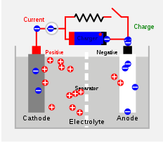
Working(charging)

Slide 44
Lead–acid battery
Nickel–cadmium battery
Types Of Secondary Batteries
Lithium-ion battery

Slide 45
Lead acid Batteries

Slide 46
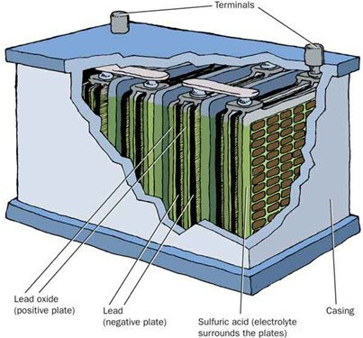
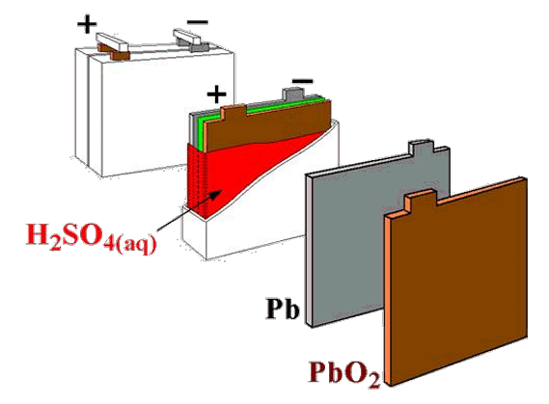
Composition of a Lead Acid Battery Positive Plate: Lead Oxide (PbO₂)
Negative Plate: Lead (Pb)
Electrolyte: sulphuric acid (H₂SO₄)
The Electrolyte: H₂SO₄
H₂SO₄ is classified as a strong acid (completely ionizes) but that is not exactly true. The first ionization of H₂SO₄ is complete and occurs instantly when in water.
H₂SO₄ 🡪 H+ + HSO4-
But! The second ionization is extremely partial.
EX: HSO₄- ⇌ H+ + SO₄⁻² (Ka = 0.012)

Slide 47
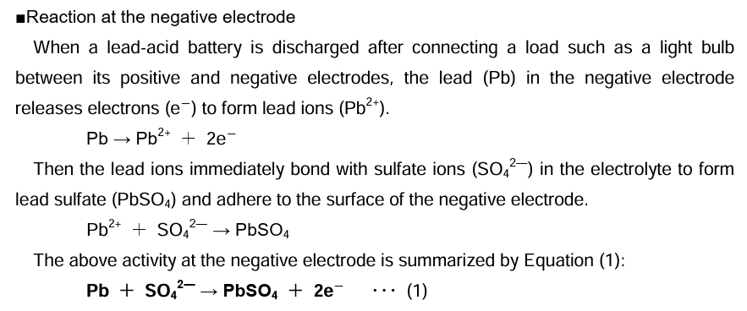
Detailed description of the Discharge Cycle

Slide 48
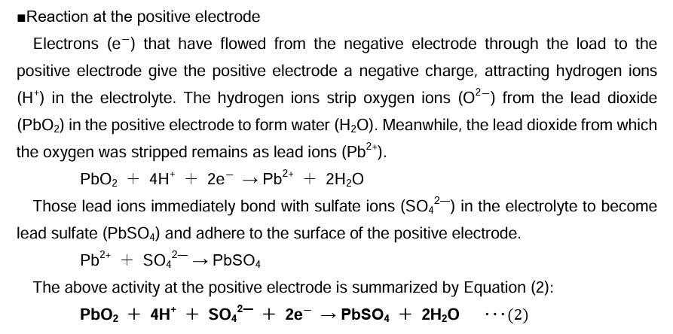
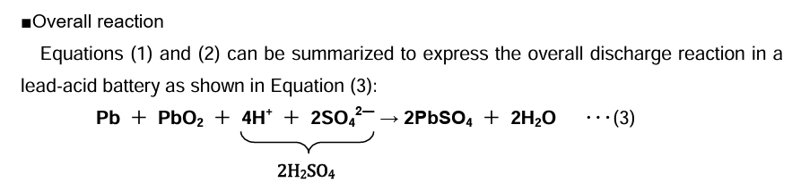

Slide 49
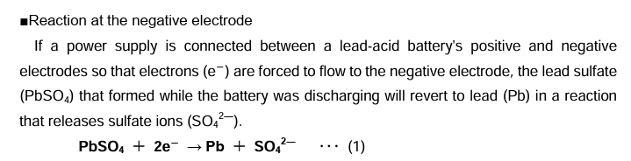
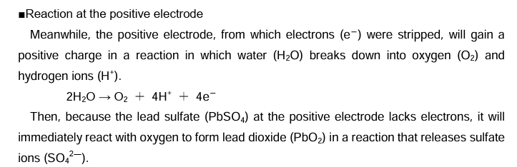
Detailed description of the Charge Cycle

Slide 50
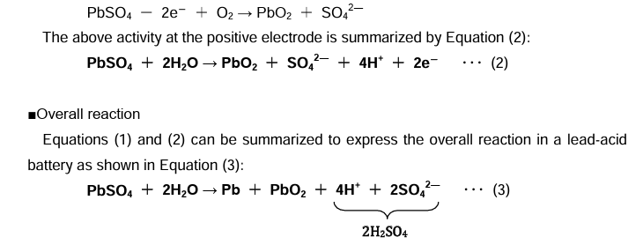
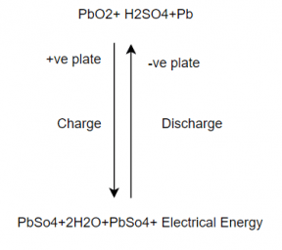
The combined equation for both the processes is represented as

Slide 51
Life
The optimum functional temperature for lead acid battery is 25⁰C which means 77⁰F. The increase in the range of temperature shortens longevity.
A per the rule, for every 80 ⁰C increase in temperature, it reduces the half-life of the battery.
While a value regulated battery that functions at 25 ⁰C has a lead acid battery life of 10 years. And when this is operated at 33⁰C, it has a life period of 5 years only.
Lead Acid Battery Applications
These are employed in emergency lighting to provide power
Used in electric motors
Submarines
Nuclear submarines

Slide 52
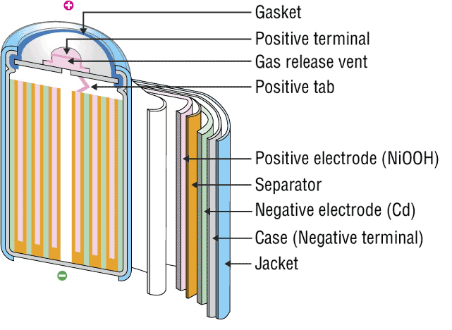
NICKEL-CADMIUM BATTERY
The nickel–cadmium battery is a type of rechargeable battery using nickel oxide hydroxide and metallic cadmium as electrodes. Ni-Cd batteries are made in a wide range of sizes and capacities.
Nickel(hydroxide)–cadmium systems are the most common small rechargeable battery type for portable appliances. The sealed cells are equipped with “jelly roll” electrodes, which allow high current to be delivered in an efficient way. These batteries are capable of delivering exceptionally high currents, can be rapidly recharged hundreds of times, and are tolerant of abuse such as over discharging or overcharging.
It produces a voltage of about 1.4 V

Slide 53
INVENTIONS AND SCOPE
Nickel-cadmium (NiCd)
Invented by Waldemar Jungner in 1899. Developments were slow, but in 1932, advancements were made to deposit the active materials inside a porous nickel-plated electrode. Further improvements occurred in 1947 by absorbing the gases generated during charge, which led to the modern sealed NiCd battery.
For many years, NiCd was the preferred battery choice for two-way radios, emergency medical equipment, professional video cameras and power tools. In the late 1980s, the ultra-high capacity NiCd rocked the world with capacities that were up to 60 percent higher than the standard NiCd.
Since the disposal of battery is hazardous to environment alternative cells are being used such as paper battery

Slide 54
RECENT TRENDS
The primary trade-off with Ni–Cd batteries is their higher cost and the use of cadmium. This heavy metal is an environmental hazard, and is highly toxic to all higher forms of batteries.
Recently, nickel–metal hydride and lithium-ion batteries have become commercially available and cheaper, the former type now rivaling Ni–Cd batteries in cost..
The batteries are more difficult to damage than other batteries, tolerating deep discharge for long periods.
Ni–Cd batteries typically last longer, in terms of number of charge/discharge cycles, than other rechargeable batteries such as lead/acid batteries.
Compared to lead–acid batteries, Ni–Cd batteries have a much higher energy density.
In consumer applications, Ni–Cd batteries compete directly with alkaline batteries. A Ni–Cd cell has a lower capacity than that of an equivalent alkaline cell, and costs more.
The capacity of a Ni–Cd battery is not significantly affected by very high discharge currents.

Slide 55
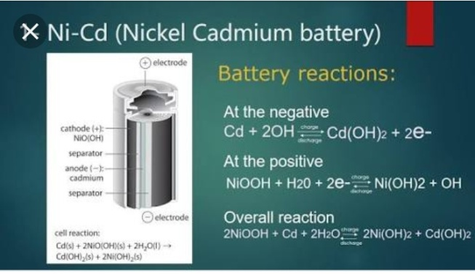
CELL REPRESENTATION AND CELL REACTION
A typical Ni-Cd battery is represented as
Cd| Cd(OH)₂|| NiO(OH)| Ni(OH)₂
Cell reaction while discharging
At Anode: oxidation of Cd metal
Cd + 2OH_ Cd(OH)₂ + 2e⁻
At cathode: reduction of NiO(OH)
2NiO(OH) + 2H₂O + 2e⁻ 2Ni(OH)₂ + 2OH⁻
Net Cell reaction:
2NiO(OH) + 2H₂O + Cd 2Ni(OH)₂ + Cd(OH)₂

Slide 56
ADVANTAGES
Fast and simple charging process
It is compact and lighter than traditional batteries
It has a longer life than lead storage batteries
Available in a wide range of sizes and performance options
Good low-temperature performance
Only battery that can be ultra-fast charged with little stress

Slide 57
LIMITATIONS
It is rather more expensive than a lead storage battery
It has a lower energy density value
Cadmium is a toxic metal
Cannot be disposed of in landfills
Memory effect; needs periodic full discharges
High self-discharge; needs recharging after storage

Slide 58
APPLICATIONS
Ni-Cd cells are popularly used in many appliances because they are available in variety of sizes and capacities.
Few examples are:
Calculators
Electronic flash units
Transistors
Cordless appliances

Slide 59
RECHARGEABLE LITHIUM Batteries

Slide 60
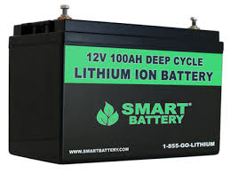
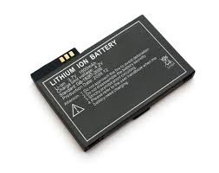
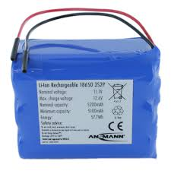
DESCRIPTION
A lithium-ion battery or Li-ion battery (abbreviated as LIB) is a type of rechargeable battery in which lithium ions move from the negative electrode to the positive electrode during discharge and back when charging.
The electrolyte, which allows for ionic movement, and the two electrodes are the constituent components of a lithium-ion battery cell.

Slide 61

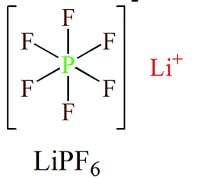
Electrolytes
Role-
Ion conduction between cathode and anode.
They are generally, Lithium salts dissolved in organic solvent.
Commercial electrolytes: in Carbonate solvent.

Slide 62
Anode Materials
Requirements:
Large capabilities of adsorption
High efficiency of charge/discharge
Low reactivity against electrolyte
Fast reaction rate
Low cost
Environment friendly
Commercial anode materials:
Hard Carbon, Graphite

Slide 63
Cathode Materials
Requirements:
A high discharge voltage
A high energy capacity
A high power density
Light weight
Low self discharge
Environment friendly
Commercial cathode materials:
LiCoO₂, LiFePO₄ etc.

Slide 64
Chemical Reactions
Main essential components:
Anode: Graphite [carbon] - C(s)
Cathode: Lithium Cobalt Oxide - LiCoO₂
Electrolyte: Typically a combination of lithium salts - LiPF₆, LiBF₄, or LiClO₄, in an organic solvent, such as either.
Separator: The separator is a very thin sheet of micro perforated plastic. [Polymer of -CH₂=CHCl]

Slide 65
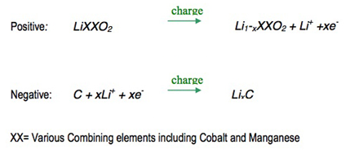
Reactions while charging
On charge the positive electrode, cathode, material is oxidized, Li⁺ ions are de-intercalated from the layered lithium LiCoO₂, pass across the electrolyte and are intercalated between the graphite layers in graphite by an electrochemical reduction reaction proceeding at the negative electrode.

Slide 66
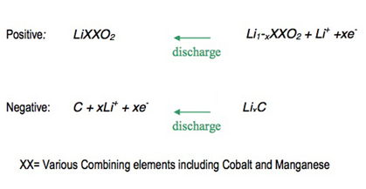
Reactions while discharging
When the cell is discharged, an oxidation reaction occurs at the negative electrode, Li+ ions are de-intercalated from the anode and migrate across the electrolyte to be re-intercalated into the cathode material, due to charge balance the equivalent number of electrons travel through the external circuit. A simultaneous electrochemical reduction reaction proceeds at the positive electrode and accepts electrons from the external circuit, Li+ ions from the electrolyte, to reform the starting material. A change from electronic current to ionic current occurs at the electrode/electrolyte interface.

Slide 67
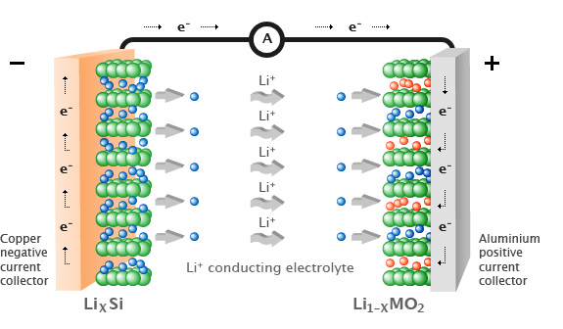
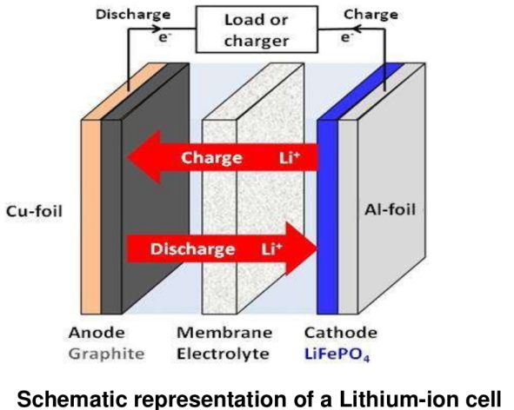


Slide 68
Applications
Emergency Power Backup Or UPS
Dependable Electric And Recreational Vehicle Power
Solar Power Storage
Reliable And Lightweight Marine Performance
Solar Power Storage
Surveillance Or Alarm Systems In Remote Locations
Personal Freedom With Mobility Equipment
Portable Power Packs that Eliminate Downtime

